Slide 1



SESSION NAME HERE
STACKS AND QUEUES

Slide 2


Foundational Sessions Housekeeping
The use of disrespectful language is prohibited in the questions, this is a supportive, learning environment for all - please engage accordingly. (FBV: Mutual Respect.)
No question is daft or silly - ask them!
There are Q&A sessions midway and at the end of the session, should you wish to ask any follow-up questions. Moderators are going to be answering questions as the session progresses as well.
If you have any questions outside of this lecture, or that are not answered during this lecture, please do submit these for upcoming Open Classes. You can submit these questions here:
SE Open Class Questions or DS Open Class Questions

Slide 3
Foundational Sessions Housekeeping cont.
For all non-academic questions, please submit a query: www.hyperiondev.com/support
Report a safeguarding incident: www.hyperiondev.com/safeguardreporting
We would love your feedback on lectures: Feedback on Lectures

Slide 4


Reminders!
Guided Learning Hours
By now, ideally you should have 7 GLHs per week accrued. Remember to attend any and all sessions for support, and to ensure you reach 112 GLHs by the close of your Skills Bootcamp.
CONFIDENTIAL

Slide 5
Progression Criteria
✅ Criterion 1: Initial Requirements
Complete 15 hours of Guided Learning Hours and the first four tasks within two weeks.
✅ Criterion 2: Mid-Course Progress
Software Engineering: Finish 14 tasks by week 8.
Data Science: Finish 13 tasks by week 8.
✅ Criterion 3: Post-Course Progress
Complete all mandatory tasks by 24th March 2024.
Record an Invitation to Interview within 4 weeks of course completion, or by 30th March 2024.
Achieve 112 GLH by 24th March 2024.
✅ Criterion 4: Employability
Record a Final Job Outcome within 12 weeks of graduation, or by 23rd September 2024.
CONFIDENTIAL

Slide 6


What is the time complexity of the 'push' and 'pop' operations in a typical stack implementation?
O(1) for both push and pop
O(n) for push and O(1) for pop
O(1) for push and O(n) for pop
O(n) for both push and pop

Slide 7
Which of the following data structures is typically used to implement a simple queue?
Array
Linked List
Hash Table
Both Arrays and Linked Lists

Slide 8
What is a distinguishing feature of a priority queue compared to a standard queue?
Elements are removed based on their priority rather than their order in the queue.
Elements are always sorted in ascending order.
Elements can only be numeric values.
Priority queues have faster access times than standard queues.

Slide 9

Recap of Linear Data Structures

Slide 10

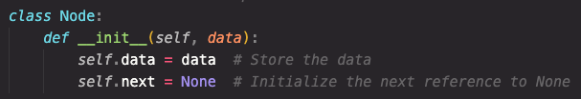
Singly Linked List
A singly linked list is a collection of nodes, where each node contains data and a reference to the next node.
Ideal for dynamic data storage where the size of the data set isn't fixed.
A node has two attributes: data (the value it holds) and next (reference to the next node).

Slide 11
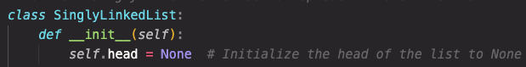
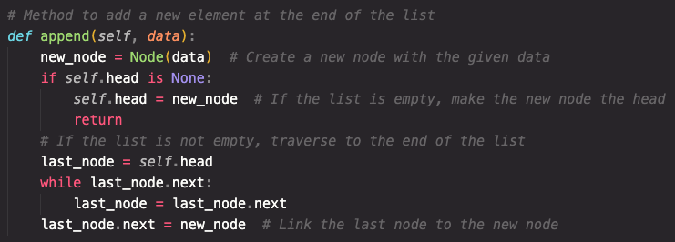
Singly Linked List Implementation
Initialising a singly linked list:
Appending a new element to a singly linked list:

Slide 12
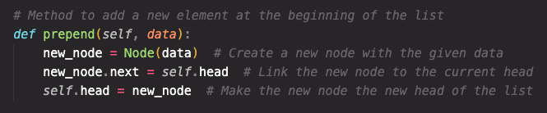
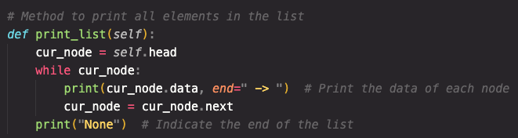
Singly Linked List Implementation
Prepending a new element to a singly linked list:
Traversing through elements in a singly linked list:

Slide 13
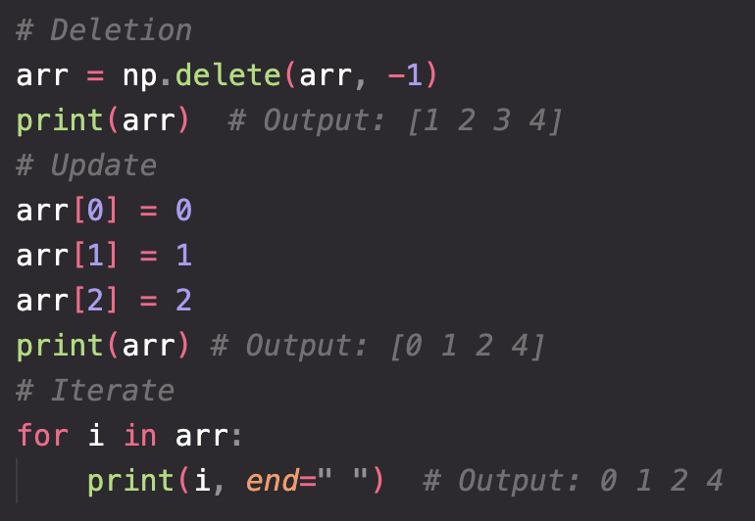
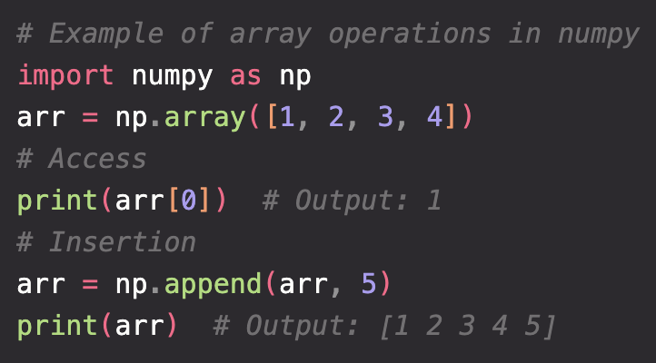
Arrays
Arrays are a fixed size data structure for storing elements in sequential memory locations.
Common operations include accessing elements, updating values, and iterating over elements.

Slide 14
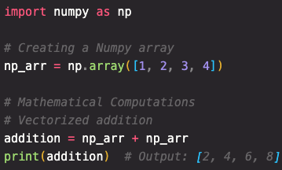
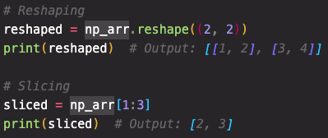
Numpy Array Operations
Operations include mathematical computations, reshaping, slicing, and more. Numpy arrays also support vectorized operations, making calculations faster.

Slide 15
Performance Comparison
Numpy Array
Access: O(1)
Append: O(n) - when creating new array
Delete: O(n)
Iteration: O(n), but faster due to contiguous memory and cache efficiency
Vectorized Operations: O(n)
Python List
Access: O(1)
Append: O(1)
Delete: O(n)
Iteration: O(n), but slower. Especially on large data sets.
Vectorized Operations: Not supported.

Slide 16

Stacks and Queues Topics
Introduction to Stacks and Queues
Implementing Stacks
Implementing Queues
Implementing Priority Queues

Slide 17
Task Management
Consider a software development team working on multiple projects at the same time. Each developer is assigned tasks from each project and these tasks need to be stored somewhere.
For one group of projects, tasks need to assigned in the order that they were submitted.
Another group of projects require that the newest tasks be assigned first.
The other group of projects have prioritised tasks and tasks with the highest priority need to be assigned first.

Slide 18
Task Management
How can we use different data structures to organise the different lists of tasks in the most efficient way?
How do we efficiently organise data that will be removed from the structure in a particular order?
How do we guarantee that data will be removed and added to the structure in the correct manner?
How can we evaluate the efficiency of these data structures?

Slide 19

Example: Organising Tasks
Project A: This project has been released for a while and users may suggest different features to be added to the project.
These suggestions can be added to a “queue”. Whichever suggestion was made first would be added to the project first.
Project B: This project is in the process of being developed and suggestions of the most useful features are made by the developers throughout the development of the project.
Features can be added to a “stack”. Whichever feature was most recently suggested would be added to the project first.
Project C: This project has just been released and a lot of users are experiencing bugs of varying severity.
Issues can be added to a “priority queue” organised by the severity of the bug. Issues that are the most severe would have the highest priority.

Slide 20
Stacks and Queues
Types of linear data structures that allow for storage and retrieval of data based on a specific method of ordering.
Data structures allow us to organise storage so that data can be accessed faster and more efficiently.
Stacks and queues are simple, easy to implement and widely applicable.
Each has defined methods of ordering and operations for adding and removing elements to and from the structure.
Can be implemented using an Array, Linked List or the deque or queue modules in Python.

Slide 21
Stacks
Method of Ordering
LIFO: Last element added to the stack is the first to be removed
Elements are added on top of one another in a “stack”
A pointer points to the element at the top of the stack
Operations
Push: Adds an element to the top of the stack
Pop: Removes the element from the top of the stack
PUSH
POP
Item 4
Item 4
Item 4
Item 3
Item 2
Item 1
Item 4
Item 3
Item 2
Item 1
top
top

Slide 22
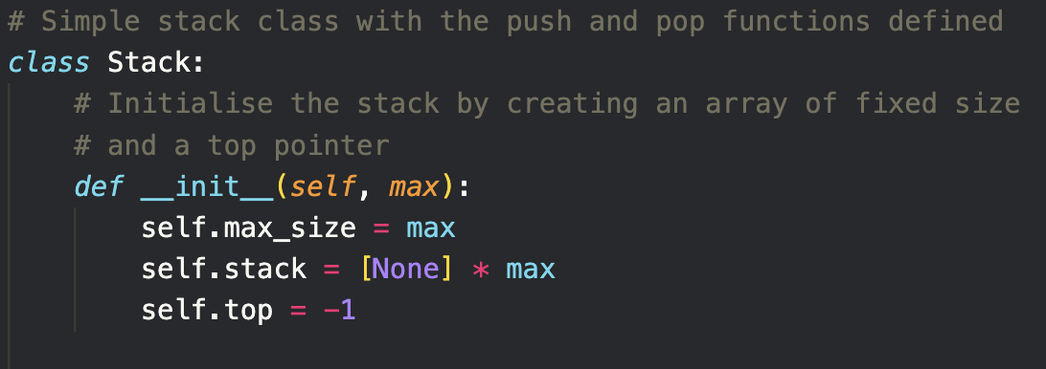
Stacks: Array Implementation
Note: This implementation is the most efficient. Be careful when attempting to implement a stack using the built-in insert() and pop() methods since it’s slower to pop or insert an element at any other position besides the end of the list [O(n)].

Slide 23
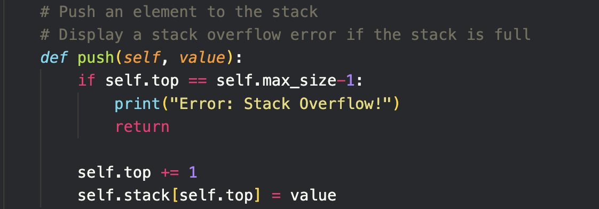
Stacks: Array Implementation
Note: This implementation is the most efficient. Be careful when attempting to implement a stack using the built-in insert() and pop() methods since its slower to pop or insert an element at any other position besides the end of the list [O(n)].

Slide 24
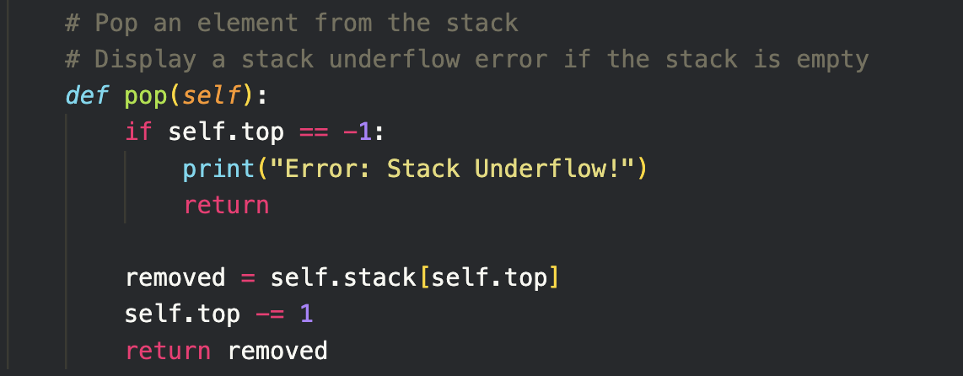
Stacks: Array Implementation
Note: This implementation is the most efficient. Be careful when attempting to implement a stack using the built-in insert() and pop() methods since its slower to pop or insert an element at any other position besides the end of the list [O(n)].

Slide 25
Stacks
Complexity Analysis
Push
Space: O(1)
No extra space is used
Time: O(1)
A single memory allocation
done in constant time
Common Uses
Function and Recursive Calls
Undo and Redo Mechanisms
“Most recently used” features
Pop
Space: O(1)
No extra space is used
Time: O(1)
Pointer is decremented by 1
Backtracking algorithms
Expression evaluations and syntax parsing

Slide 26
Queues
Method of Ordering
FIFO: First element added to the stack is the first to be removed
Elements added to rear of a “queue” and removed from front
Two pointers point to the front and the rear
Operations
Enqueue: Adds an element to the end of the queue
Dequeue: Removes the element from the front of the queue
front
back
DEQUEUE
ENQUEUE
Item 1 | Item 2 | Item 3 | Item 4 | Item 5
Item 1
Item 5

Slide 27
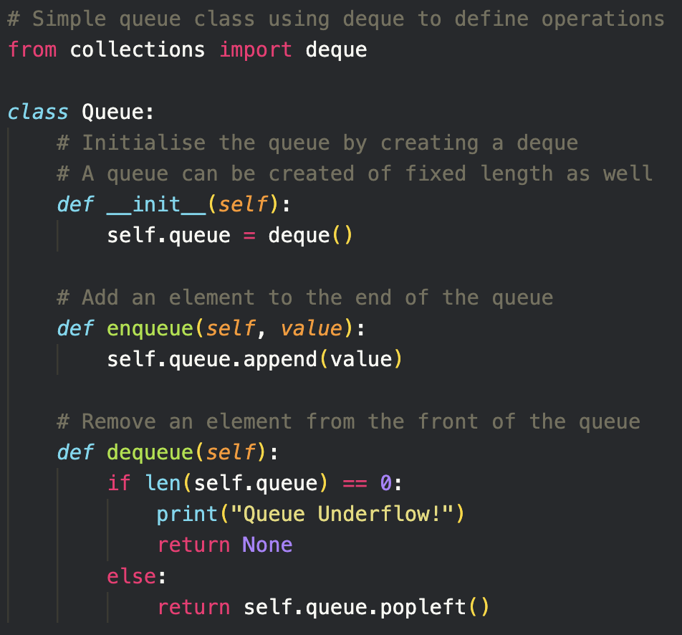
Queues: deque Implementation
deque makes use of a doubly-linked list
Note: Lists can be used to implement a queue, but this will either come at a cost of time, since using the pop(n) function has an O(n) time complexity, or at a cost of space, since using pointers would mean that the list would grow infinitely but also have empty elements in the front.
Notes:
This implementation can be done with a list but it is not the most efficient (space wise or time wise)

Slide 28
Queues: deque Implementation
Notes:
This implementation can be done with a list but it is not the most efficient (space wise or time wise)

Slide 29
Queues
Complexity Analysis
Enqueue
Space: O(1)
No extra space used
Time: O(1)
Single memory allocation
done in constant time
Common Uses
Task Scheduling
Resource Allocation
Network Protocols
Dequeue
Space: O(1)
No extra space used
Time: O(1)
Front pointer incremented by 1 and node deallocated
Printing Queues
Web Servers
Breadth-First Search

Slide 30
Priority Queues
Method of Ordering
Arranged according to the assigned priority of elements
Order direction doesn’t matter, as long as the highest priority elements are removed first
Operations
Enqueue: Adds an element to the queue based on its priority
Dequeue: Removes the highest priority element from the queue
front
back
DEQUEUE
ENQUEUE
Item 2 P: 10 | Item 3 P: 8 | Item 1 P: 7 | Item 5 P: 4 | Item 4 P: 1
Item 2 P: 10
Item 5 P: 4
Notes:
Order direction - referring to whether the list starts with the highest priority element or the lowest

Slide 31
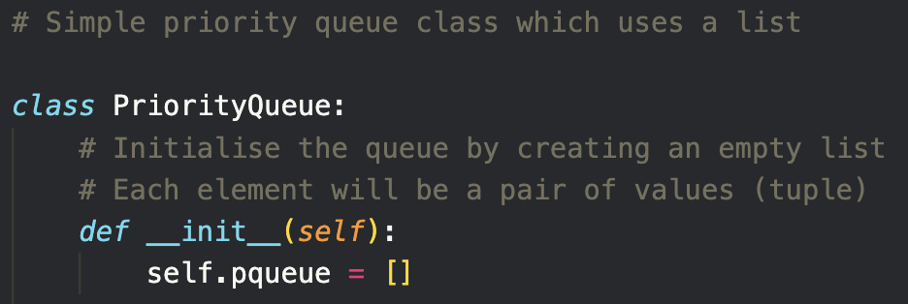
Priority Queues: List Implementation
Note: The sort function is used at all times so elements are added to a sorted list which improves time complexities. The list is sorted in ascending order so that the element at the end of the list has the highest priority thus the pop() will have a O(1) complexity.

Slide 32
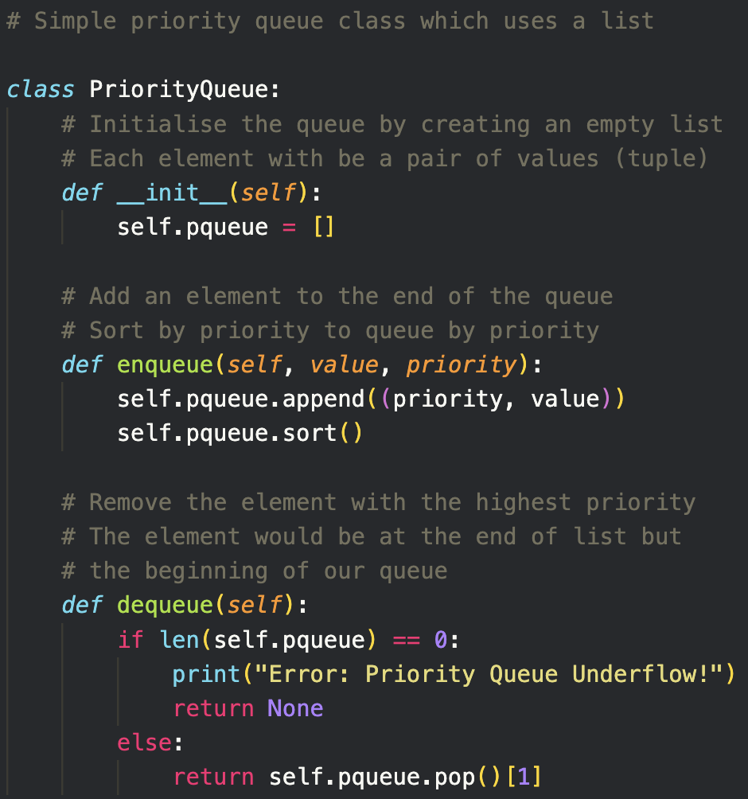
Priority Queues: List Implementation
Note: The sort function is used at all times so elements are added to a sorted list which improves time complexities. The list is sorted in ascending order so that the element at the end of the list has the highest priority thus the pop() will have a O(1) complexity.

Slide 33
Priority Queues: List Implementation
Note: The sort function is used at all times so elements are added to a sorted list which improves time complexities. The list is sorted in ascending order so that the element at the end of the list has the highest priority thus the pop() will have a O(1) complexity.

Slide 34
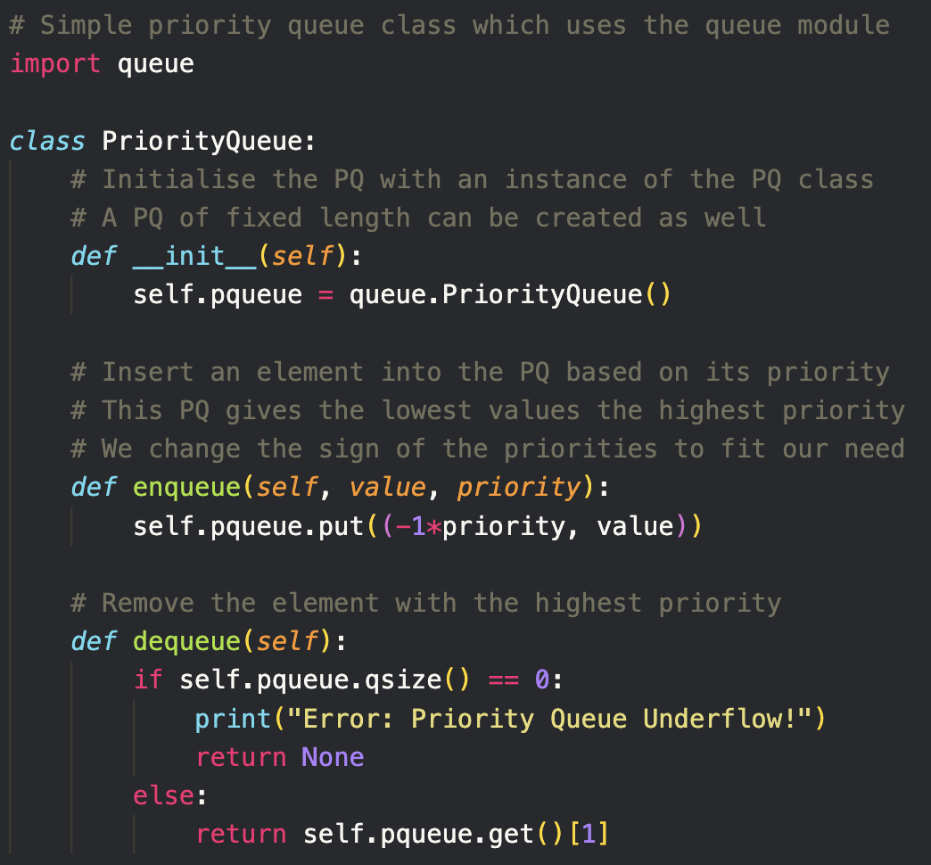
Priority Queues: queue Implementation
Note: This implementation makes use of a structure called a min-heap to improve efficiency. A min-heap maintains that all parent nodes are less than or equal to all child nodes.

Slide 35
Priority Queues: queue Implementation
Note: This implementation makes use of a structure called a min-heap to improve efficiency. A min-heap maintains that all parent nodes are less than or equal to all child nodes.

Slide 36
Priority Queues: queue Implementation
Note: This implementation makes use of a structure called a mini-heap to improve efficiency. A min-heap maintains that all parent nodes are less than or equal to all child nodes.

Slide 37
Priority Queues
Complexity Analysis
Enqueue
Space:
List - O(1)
No extra space is used
PriorityQueue - O(1)
No extra space is used
Time:
List - O(n)
Each element’s priority must be checked and compared
PriorityQueue - O(log n)
Adding node to heap
Dequeue
Space:
List - O(1)
No extra space is used
PriorityQueue - O(1)
No extra space is used
Time:
List - O(1)
Pointer is updated or last element is removed
PriorityQueue - O(log n)
Removing node from heap
Notes:
Depends on implementation but going off of our implementation

Slide 38
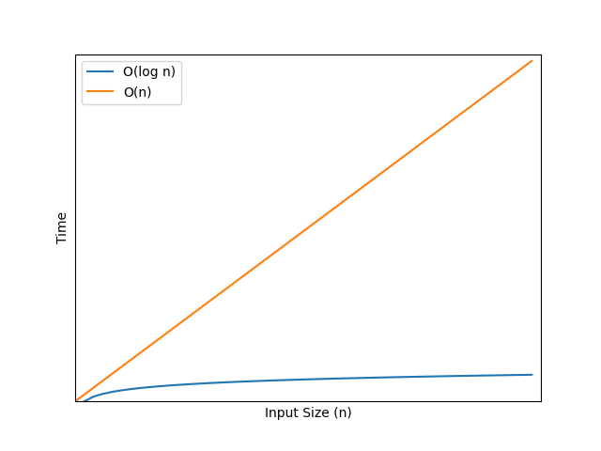
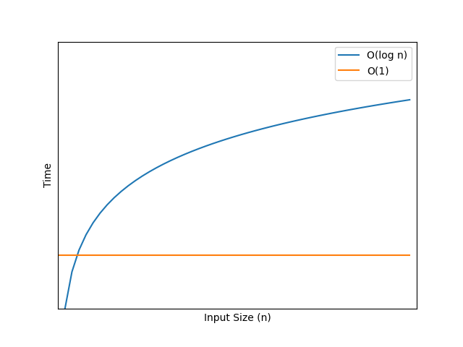
Priority Queues
Complexity Analysis Visualisation
Enqueue Time Complexity
Dequeue Time Complexity
Notes:
Depends on implementation but going off of our implementation

Slide 39
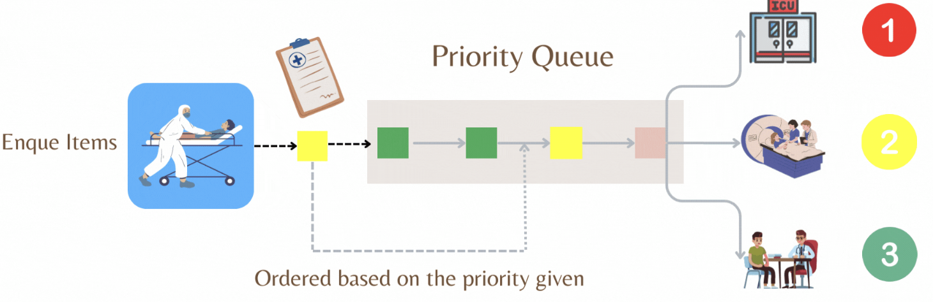
Priority Queues
Common Uses
Dijkstra’s Shortest Path Algorithm
Data Compression
Artificial Intelligence
Load Balancing in OSs
Optimisation Problems
Robotics
Medical Systems
Event-driven simulations
Source: Priority Queues in Healthcare (Medium)
Notes:
Depends on implementation but going off of our implementation

Slide 40
Worked Example
Discuss the choice between a stack or a priority queue for this implementation based on each data structure’s performance and flexibility.
Based on the answer in 1, determine under what conditions it would be better to use each structure.
Implement a simple scheduler using either a stack or a priority queue.
Consider a simple scheduler designed to manage the execution of tasks of varying priority.
We will consider two different implementations, one using a stack and another which uses a priority queue.

Slide 41
Worked Example
Discuss the choice between a stack or a priority queue for this implementation based on each data structure’s performance and flexibility.
Performance: Better speed when using a stack [O(1) vs O(log n)] but better suited order of execution with a priority queue.
Flexibility: Priority queues have better flexibility since priority can influence order of execution.
Based on the answer in 1, determine the best suited conditions for each data structure.
Stack: Performance is important and task prioritisation is not critical
Priority Queue: Task prioritisation critically impacts order of execution.
Consider a simple scheduler designed to manage the execution of tasks of varying priority.
We will consider two different implementations, one using a stack and another which uses a priority queue.

Slide 42
Worked Example
3. Implement a simple scheduler using either a stack or a priority queue.
Examples of both implementations can be found with the source code for this lecture.
Consider a simple scheduler designed to manage the execution of tasks of varying priority.
We will consider two different implementations, one using a stack and another which uses a priority queue.

Slide 43
Summary
Stacks
Order: LIFO
Operations: Push() and Pop()
Time complexity: O(1)
Space complexity: O(1)
Queues
Order: FIFO
Operations: Enqueue() and Dequeue()
Time complexity: O(1)
Space complexity: O(1)

Slide 44
Summary
Priority Queues
Order: Based on the priority of each element
Operations: Enqueue() and Dequeue()
Time complexity [List]: O(n)
Space complexity [List]: O(1)
Time complexity [PriorityQueue]: O(log n)
Space complexity [PriorityQueue]: O(log n)

Slide 45
Further Learning
StackAbuse - Stacks and Queues Basics
GeeksforGeeks - Data Structures includes in depth information and implementation of Stacks, Queues and Priority Queues
GeeksforGeeks - Stacks Complexity Analysis
GeeksforGeeks - Queues Complexity Analysis

Slide 46
Which data structure would be most appropriate for implementing a backtracking algorithm?
Stack
Queue
Priority Queue
Linked List

Slide 47
In a task scheduling system, why might a priority queue be preferred over a simple queue?
For faster access to elements.
To process tasks based on their priority.
For its Last In, First Out (LIFO) nature.
To minimise memory usage.

Slide 48
Questions and Answers
Questions around Stacks and Queues

